Slide 1
Meg Peterson Andy Shi
Kip Madden Justin Boggs

Slide 2
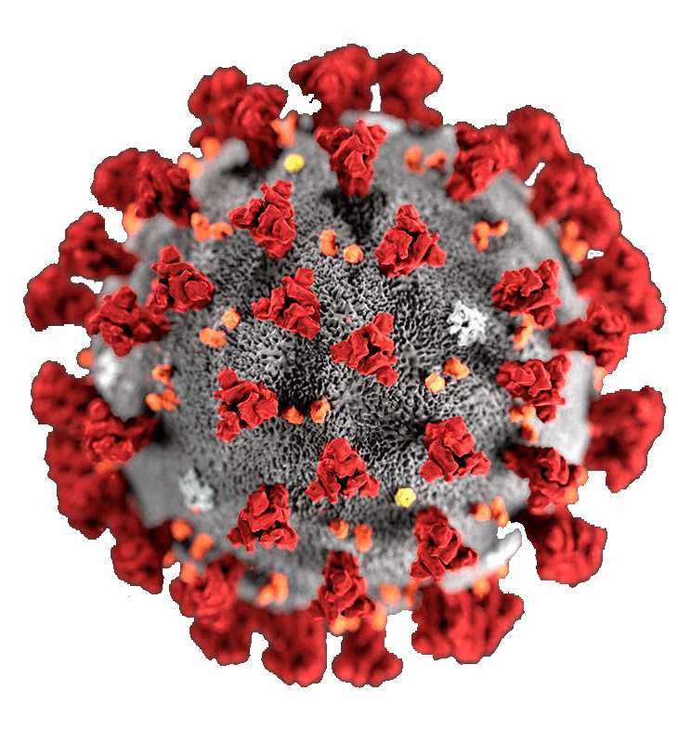
Can your country’s
individualism
harm you?
Covid
Culture
SMU Data Science Project 2

Slide 3
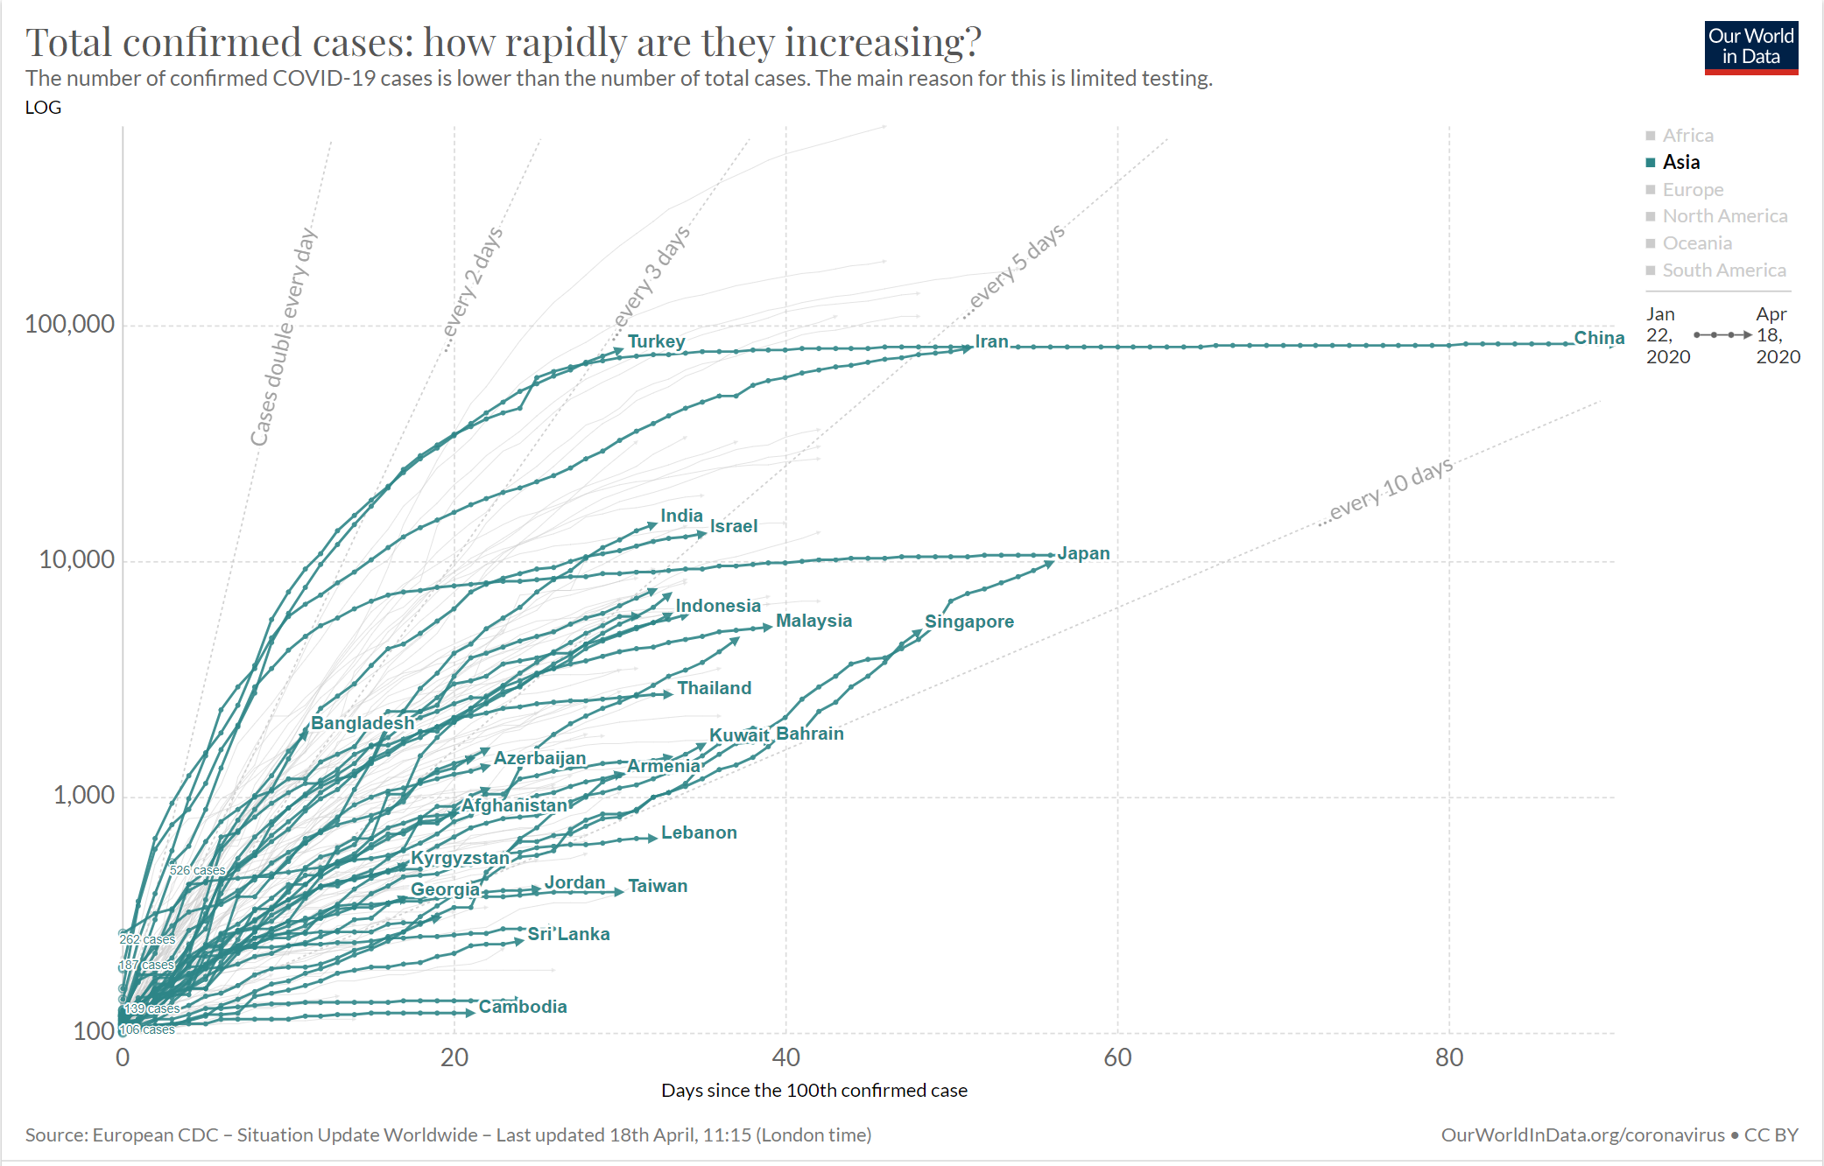
Initial Observations
Confirmed Covid cases are growing exponentially – but not for all countries

Slide 4
Can the culture of a country affect the rate of new Covid cases?

Slide 5
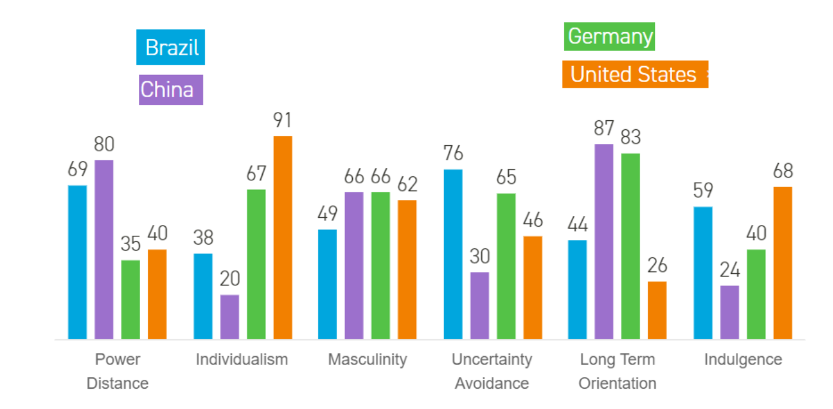
Culture has been quantified
Psychologist Dr Geert Hofstede published his cultural dimensions model at the end of the 1970s, based on a decade of research. Since then, it's become an internationally recognized standard for understanding cultural differences.

Slide 6







Hoefstede’s 6 Cultural Dimensions
^{Power Distance Index (PDI)}
^{Uncertainty Avoidance Index}
Degree of inequality that exists – and is accepted – between people with and without power
This dimension describes how well people can cope with anxiety
^{Individualism vs Collectivism}
^{Long/Short Term Orientation}
Strength of ties that people have to others within their community.
Long-term = pragmatic, modest & thrify
Short-term = emphasize principles, consistency & truth
^{Masculinity vs Femininity}
^{Indulgence vs Restraint}
Distribution of roles between men and women. Masculine expected to behave assertively.
Allow and encourage gratification of people’s drives and emotions.

Slide 7
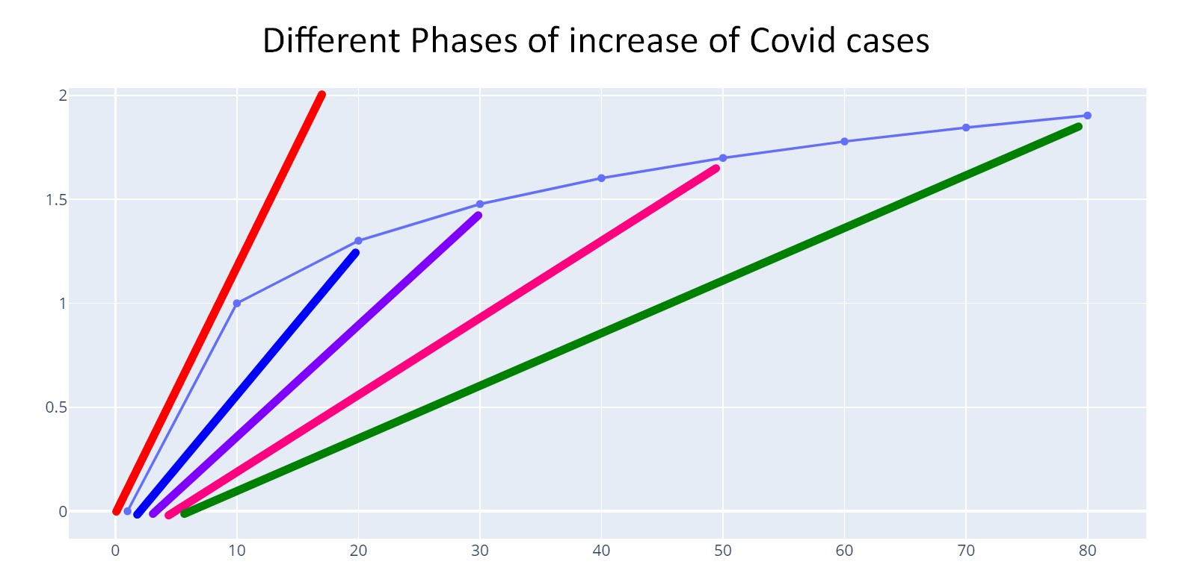

Slide 8
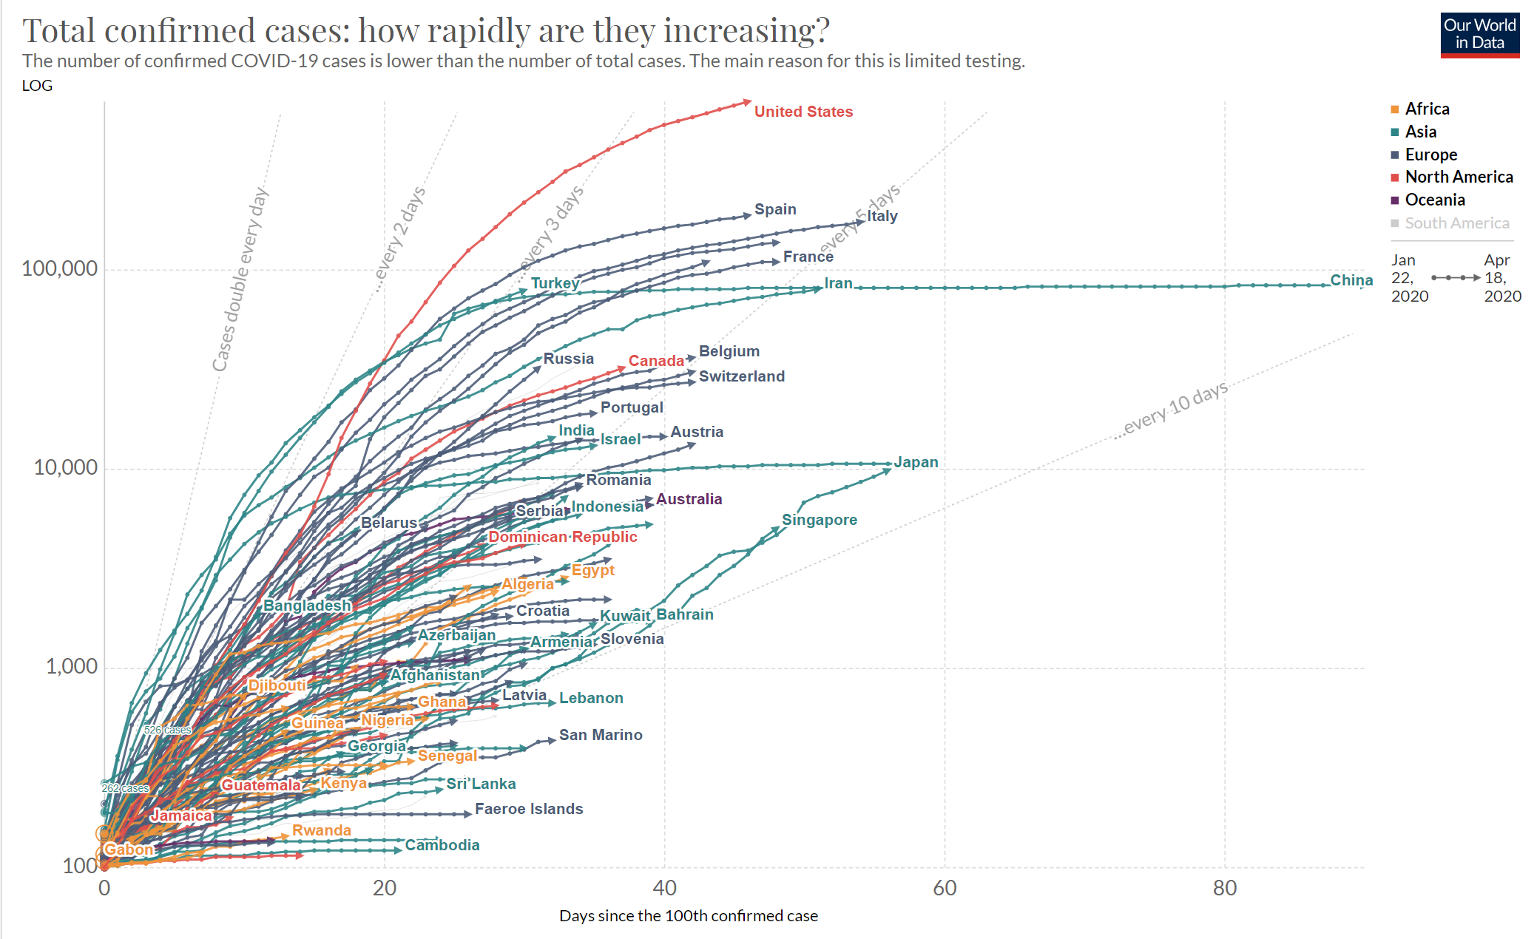

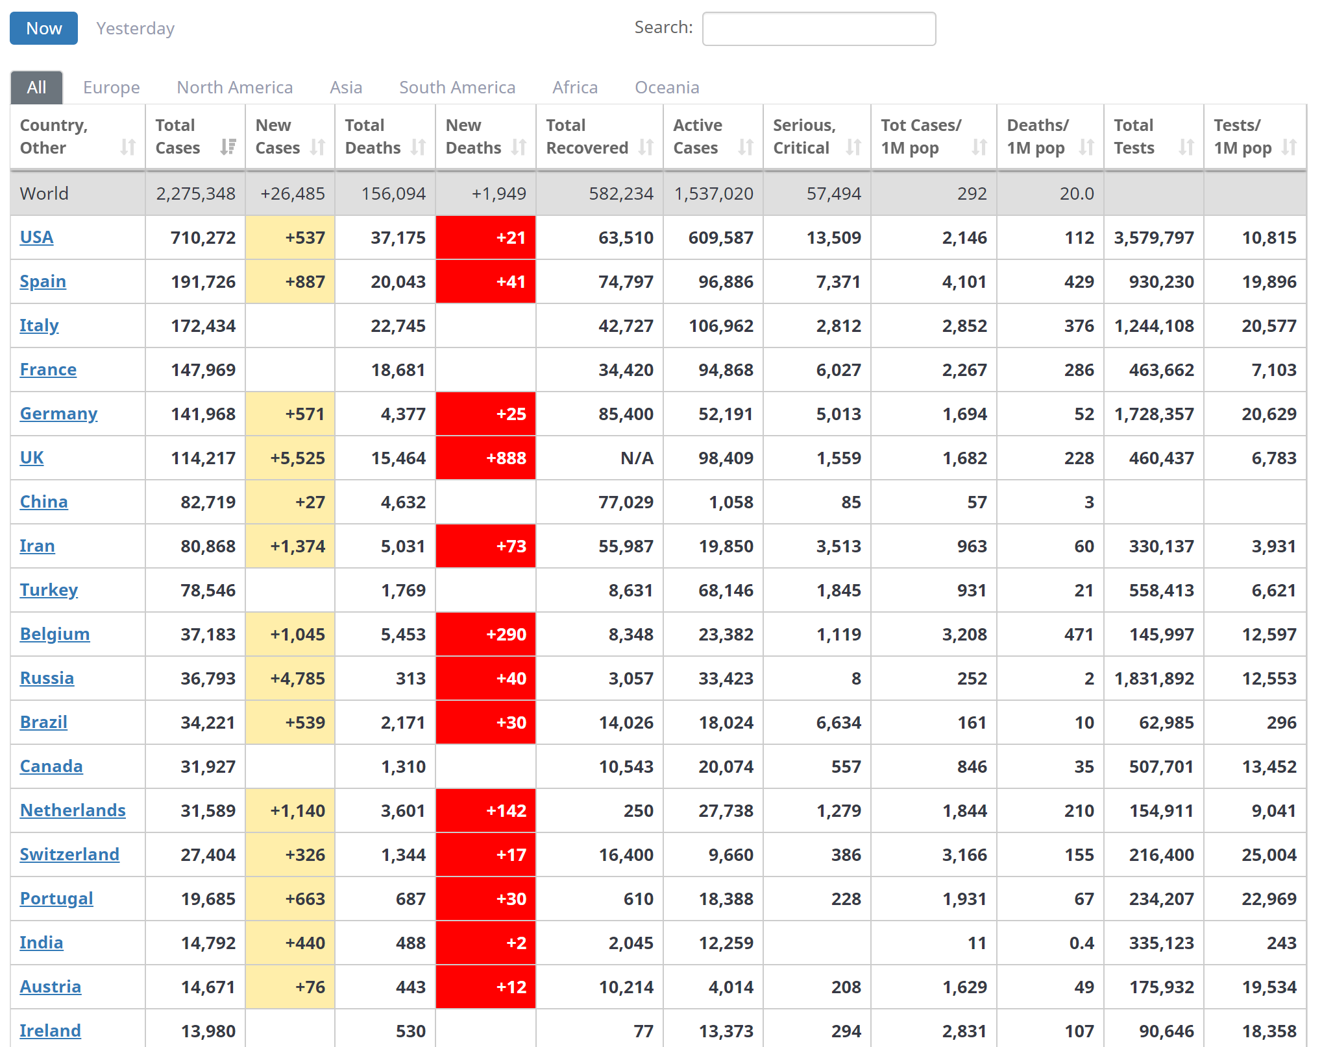
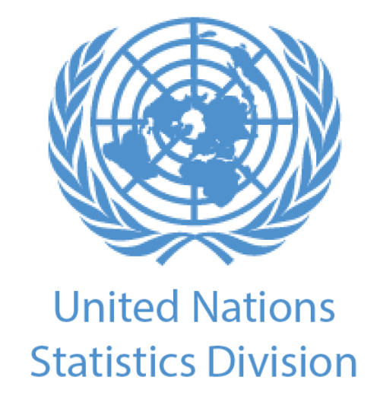


Get the Data…
Covid Confirmed Cases (Daily per Country) [Our World in Data.org
Confirmed Cases & Testing (Snapshot of a day) [Worldometer.org]
Country Data (static) United Nations Statistics Division
Cultural Dimension Data (static) Hoefstede Insights

Slide 9
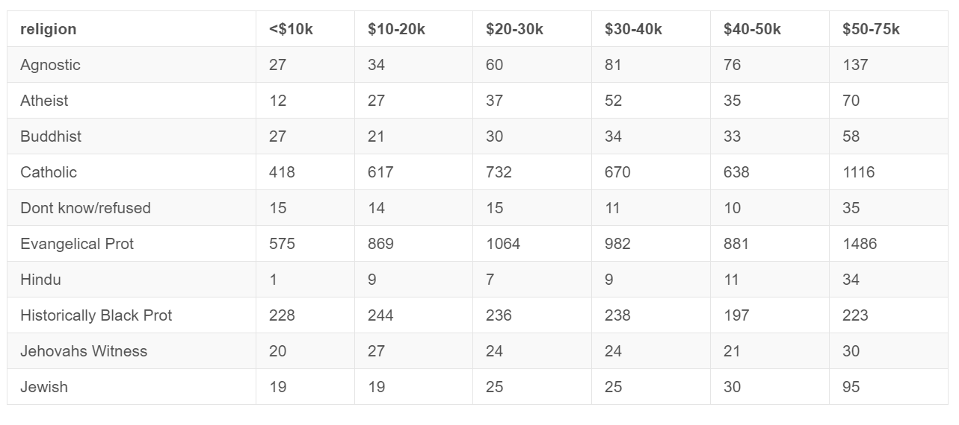
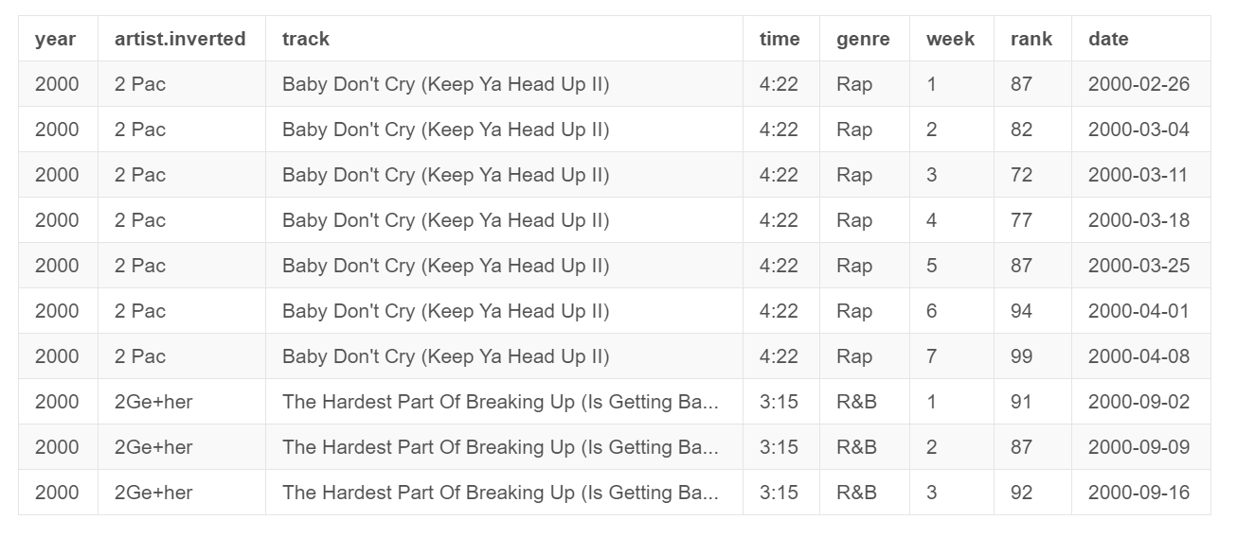
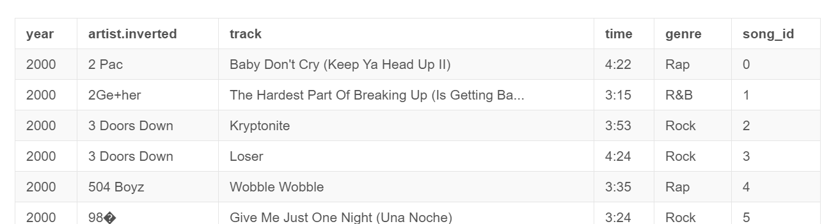
Tidy Data
Messy Data
Tidy data is an alternative name for the common statistical form called a model matrix or data matrix.

Slide 10
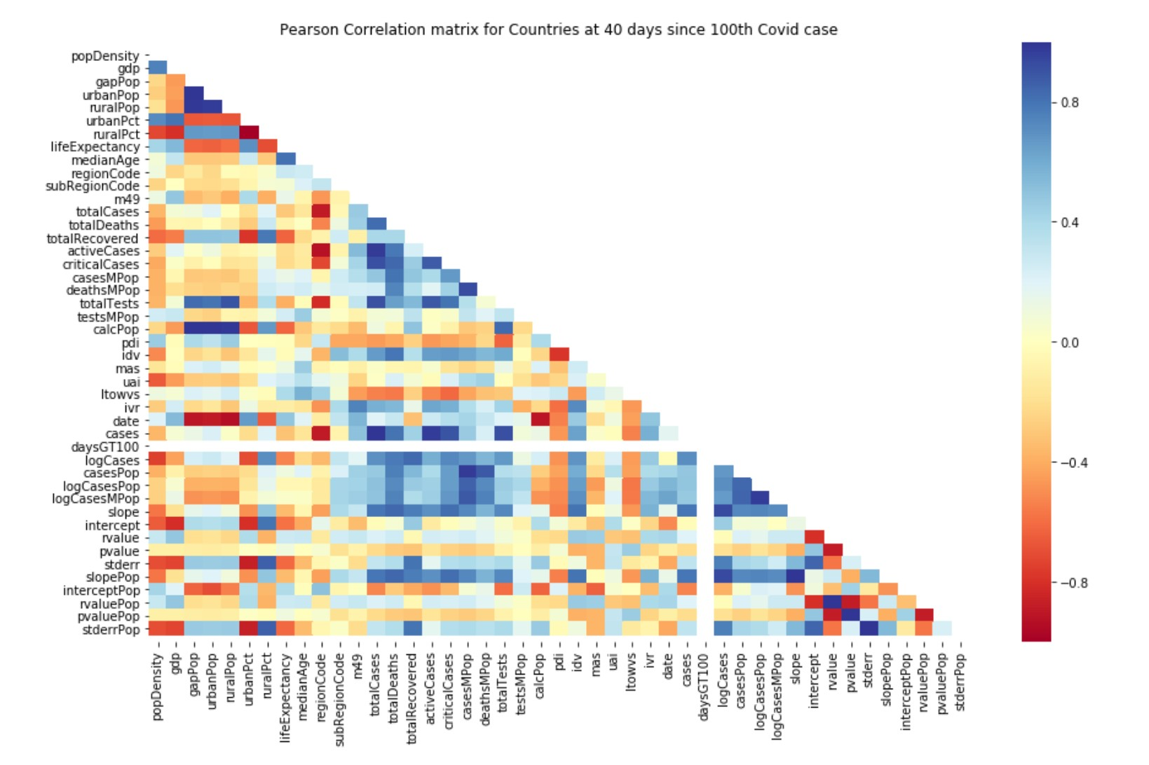

Slide 11
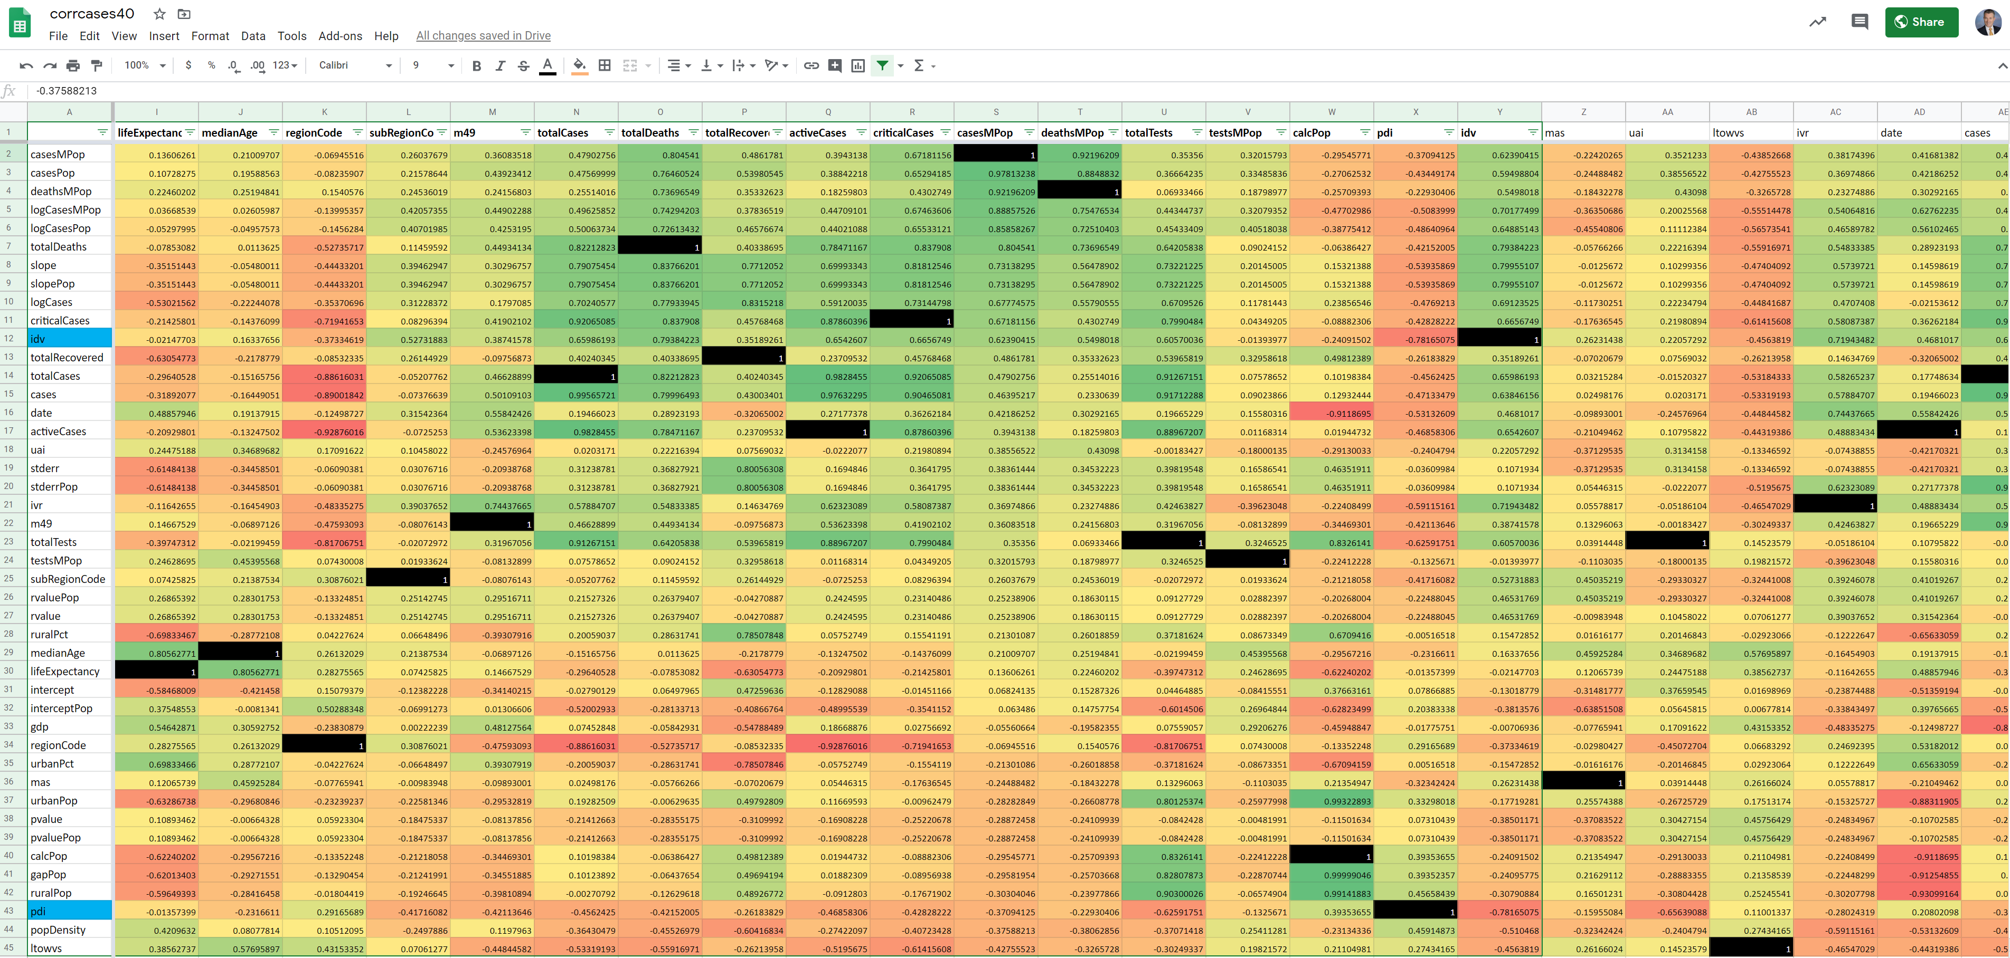

Slide 12
Data Architecture
Data Collection
Database Creation
Collect CSVs
SQLlite
Front End Web Development
Flask App
HTML, Bootstrap, CSS, Javascript
SQL Alchemy, Flask
Cleaning Data with Pandas and SQL
Data Dashboard
Generate Visualizations
Munging
D3, Plotly, Pivot Table

Slide 13
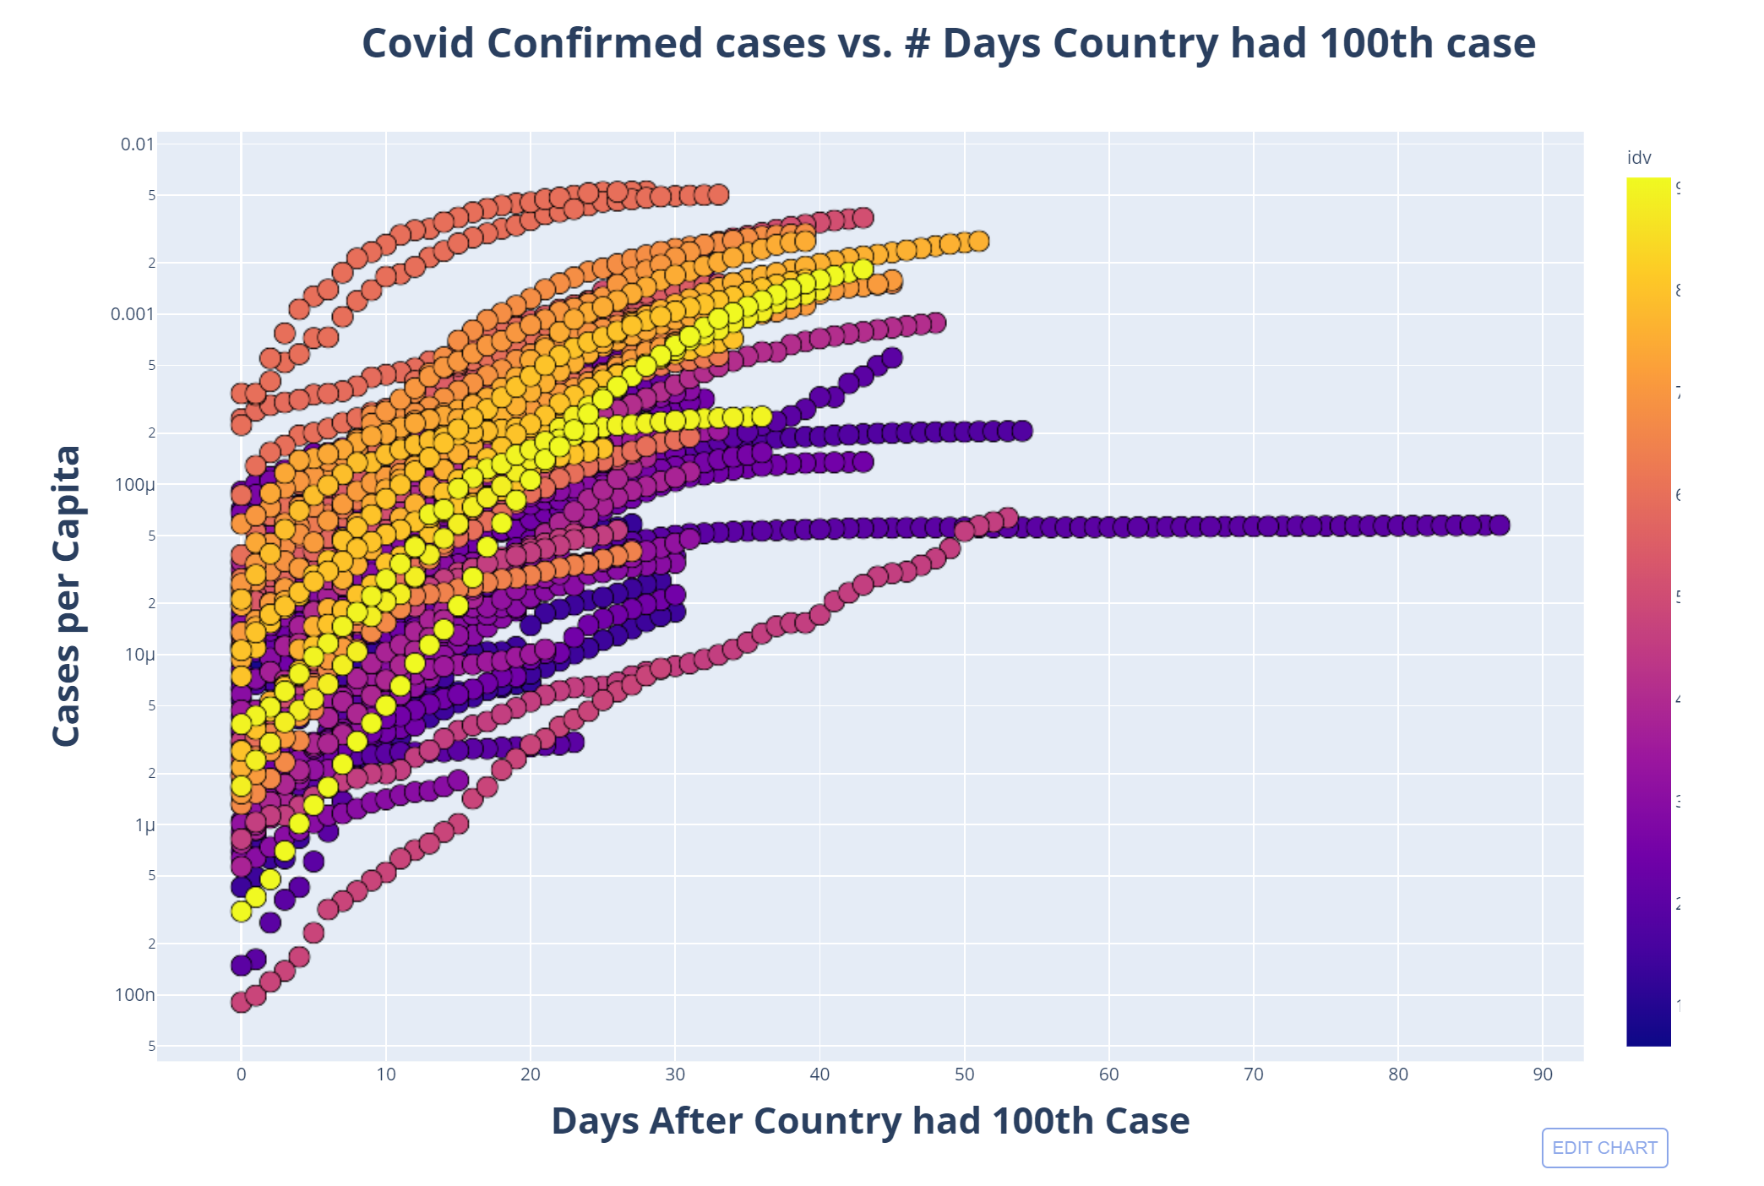

Slide 14
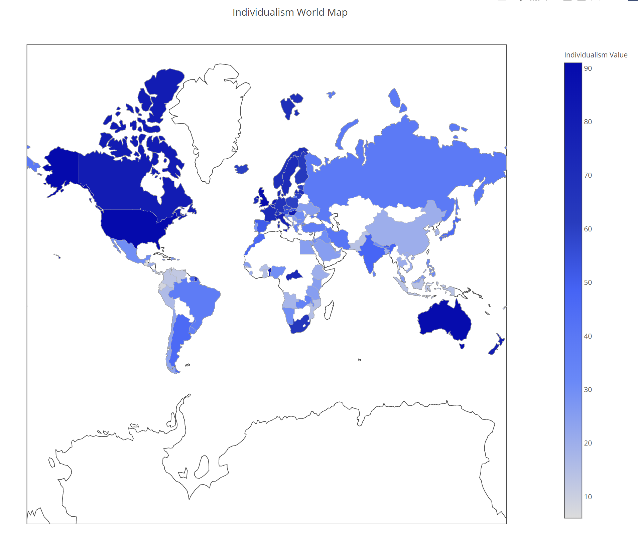

Slide 15
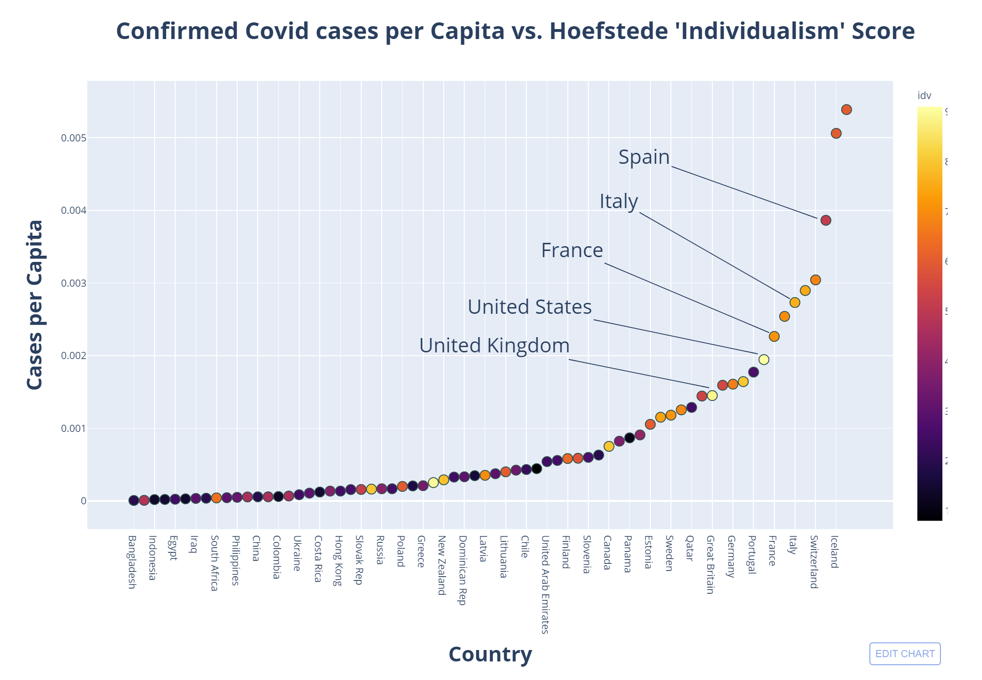

Slide 16
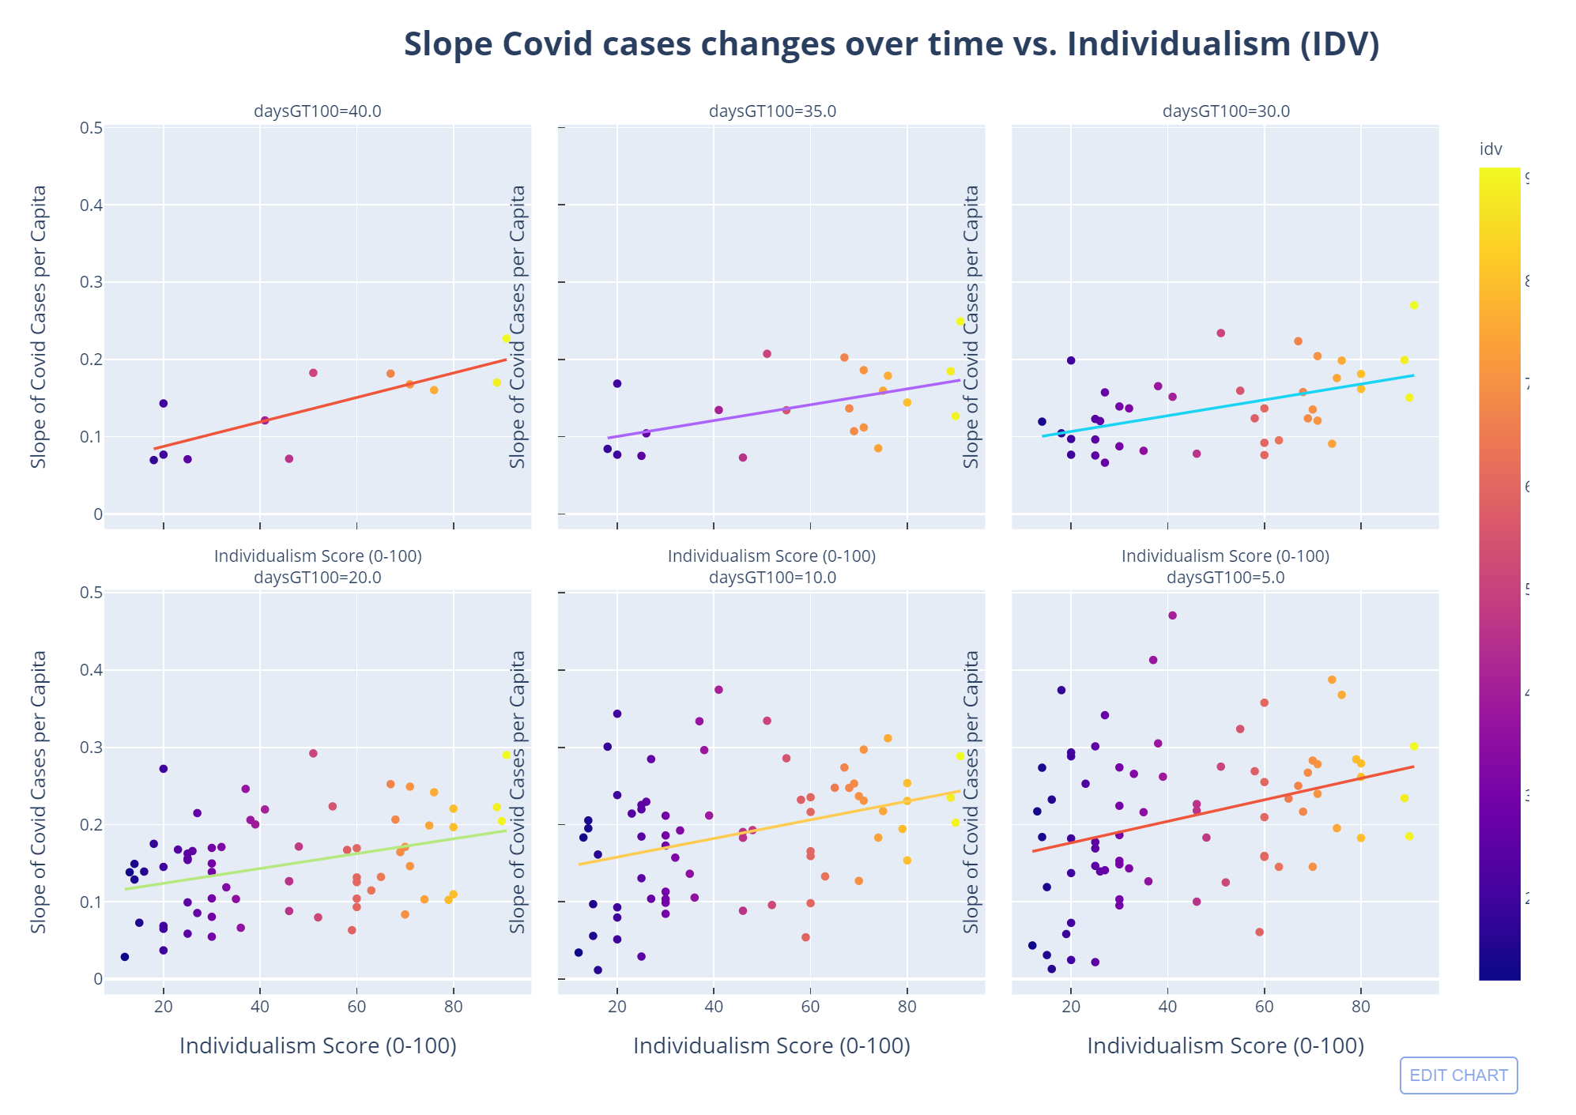

Slide 17
Conclusion
Culture does appear to influence rate of spread of the Corona virus. Specifically the degree of Individualism

